Slide 1
NTED-TPP NIMS Reviews – Resource Typing Library Tool
February 25, 2021

Slide 2
Agenda
Welcome
Purpose of Webinar
Speakers Introduction
Overview of the NIMS components
Spotlight on the NIMS Resource Typing Library Tool
Overview of the NIMS Course Review Process

Slide 3
Purpose and Speakers
Purpose – to provide basic and refresher education on the 2017 NIMS Doctrine, introduction to the NIMS Resource Typing Library Tool
Speakers
Will Schroeder, Acclaro, TPP Program Manager
Chris Smith, Acclaro, Project Manager
Dave Pasquale, CTOS, Technical Standards Manager

Slide 4
Learning Objectives
Participants will:
Have an introductory understanding of the role of resource typing and its relationship to other NIMS components.
Be aware of the Resource Typing Library Tool and its basic functions.
Be able to utilize the Resource Typing Tool to gather information relevant to a given course they are developing.
Have an introductory understanding of how Resource Typing is incorporated in the Acclaro NIMS review process.
Be able to understand if NIMS components are relevant for a given course they are developing.

Slide 5
NIMS Consistency
A NIMS Review of training course materials should be conducted for consistency-not compliance-with NIMS.
Consistency is defined as:
in agreement with
holding to the same principles and practices and
not contradictory to
In some instances, a course may not be fully compliant with NIMS, but it will be consistent with the NIMS concepts, terms, wording, and requirements. Such a course would pass a NIMS Review.

Slide 6
NIMS Consistency
Courses developed within the Training Partners Program should be consistent with NIMS
All courses currently undergo a NIMS review to ensure that the courses:
Materials that relate to the NIMS Doctrine are consistent with the 2017 version of NIMS
Materials that are presented do not conflict with the NIMS Doctrine
NIMS components that are integral to the learning objectives of the course are included

Slide 7
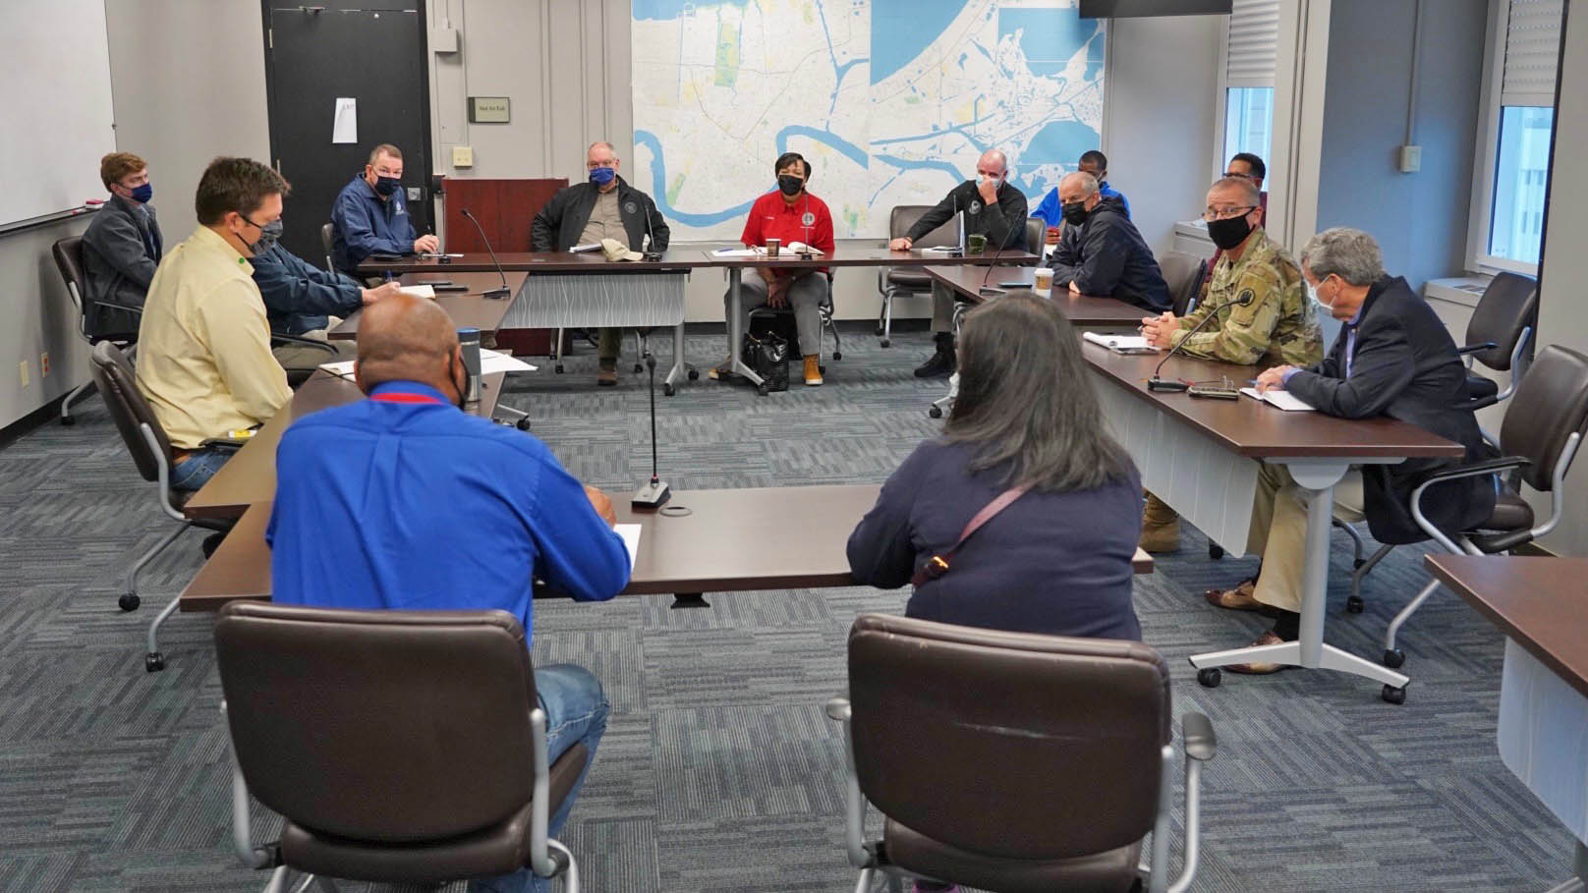
NIMS Fundamental Concepts
Reference for NIMS Reviews: 2017 NIMS Doctrine
Guiding Principles
Flexibility
Standardization
Unity of Effort
Key Terms

Slide 8
NIMS Component 1: Resource Management
NIMS Resource Management guidance enables many organizational elements to collaborate and coordinate to systematically manage resources—personnel, teams, facilities, equipment, and supplies.
Resource Management Preparedness
Resource Management During an Incident
Mutual Aid

Slide 9
NIMS Component 2: Command and Coordination
The Command and Coordination component of NIMS describes the systems, principles, and structures that provide a standardized, national framework for incident management.
Regardless of the size, complexity, or scope of the incident, effective command and coordination—using flexible and standard processes and systems—helps save lives and stabilize the situation.
Incident command and coordination consist of four areas of responsibility:
Tactical activities to apply resources on scene;
Incident support, typically conducted at EOCs, through operational and strategic coordination, resource acquisition and information gathering, analysis, and sharing;
Policy guidance and senior-level decision making; and
Outreach and communication with the media and public to keep them informed about the incident.

Slide 10
NIMS Component 3: Communication and Information Management
Incident personnel rely on flexible communications and information systems to obtain and provide accurate, timely, and relevant information.
Establishing and maintaining situational awareness and ensuring accessibility and voice and data interoperability
Properly planned, established, and applied communications facilitate information dissemination among command and support elements and cooperating jurisdictions and organizations.
Key concepts:
Interoperability
Reliability, scalability, and portability
Resiliency and redundancy
Security

Slide 11
NIMS Component 1: Resource Management 1 of 4
A deeper dive:
Resource management preparedness – identifying and typing resources, the Resource Typing Library Tool
Qualifying, certifying, and credentialing personnel
Acquiring, storing, and inventorying resources
Resource management process – identifying requirements, ordering and acquiring, mobilization, tracking and reporting, demobilization, reimbursement, and restocking
Mutual aid – agreements and process

Slide 12
NIMS Component 1: Resource Management 2 of 4
Resource Typing Library Tool – online catalogue of national NIMS resource typing definitions and job titles/position qualifications.
Resource Typing Definitions - provided for equipment, teams and units. They are used to categorize, by capability, the resources requested, deployed and used in incidents. Measurable standards identifying resource capabilities and performance levels serve as the basis for this categorization.
• Job Titles and Position Qualifications - used in the inventorying, credentialing and qualifying of personnel. Credentialing is essential in validating the identity and attributes (e.g., affiliations, skills or privileges) of emergency personnel.

Slide 13
NIMS Component 1: Resource Management 3 of 4
Resource Typing – why is it important?
Resource typing is critical for mutual aid – speaking the same language
Example – Mass Casualty Incident – patient transport resources will be needed from within and likely from out of state
Variables
Type of ambulance
Ground
Air (fixed wing/rotary wing)
Critical care/Non-critical care (ALS/BLS)
Number
Single resource
Strike Team – 5 ambulances of same type (ALS/BLS), leader in separate vehicle – typed according to various resource components
Task Force – 5 ambulances of different type (ALS/BLS), leader in separate vehicle

Slide 14
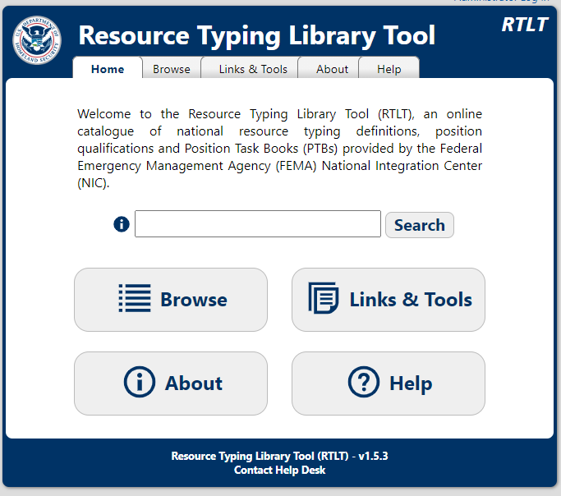
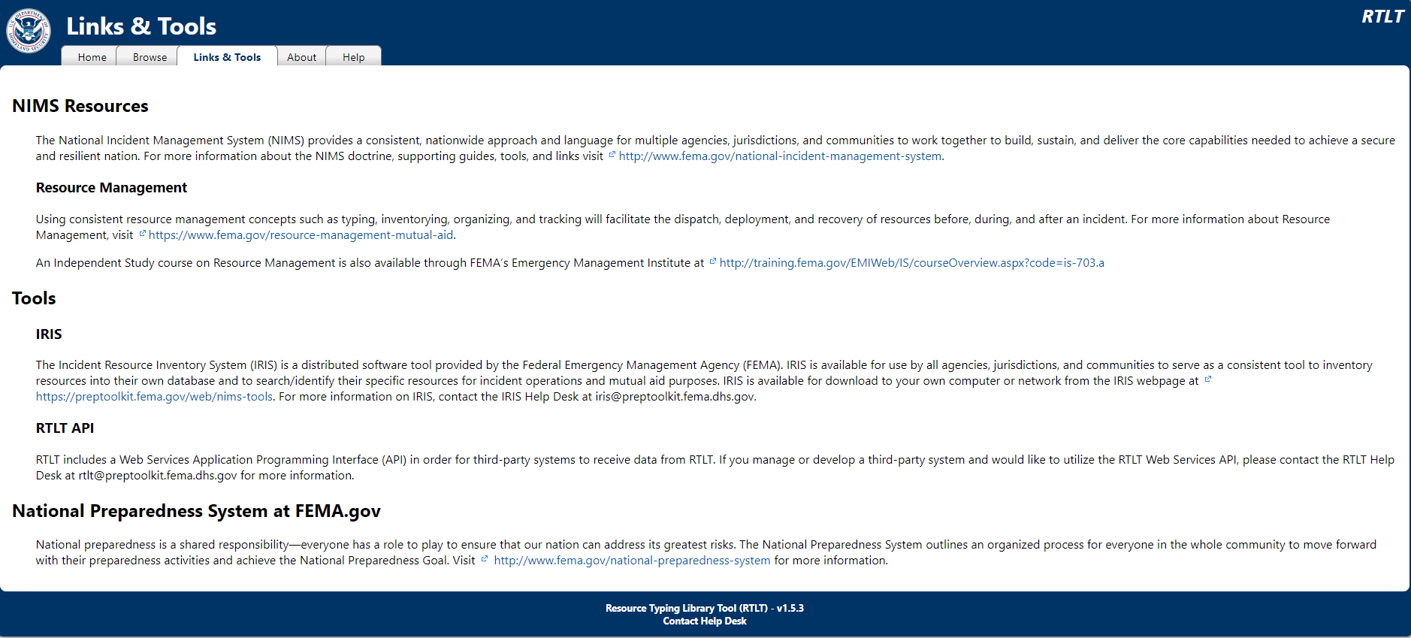
NIMS Component 1: Resource Management 4 of 4
The FEMA NIMS Resource Typing Library Tool can be found at this link: Resource Typing Library Tool - RTLT (fema.gov)
Notes:
We will now do a short demonstration of the Resource Typing Library Tool. The tool is available at https://rtlt.preptoolkit.fema.gov/public
Once you have accessed the tool, you will see 5 tabs at the top of the screen – review these. Navigate through each of the tabs and explain the components

Slide 15
NIMS Component 1: Resource Management – Resource Typing Library Tool

Slide 16
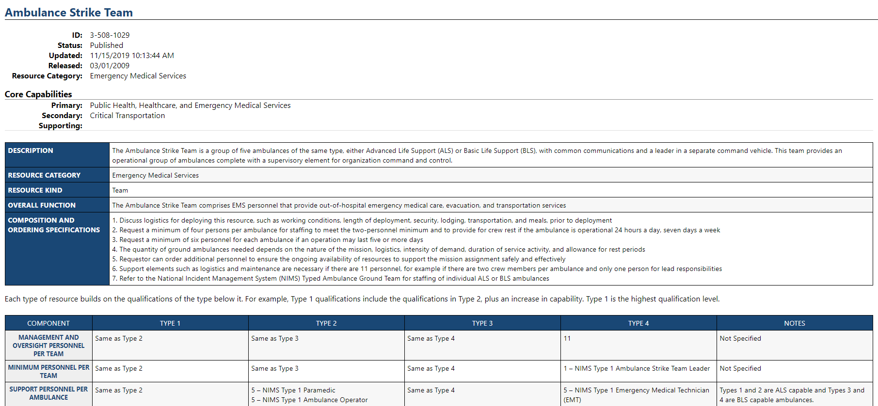
NIMS Component 1: Resource Management – Resource Typing Library Tool, continued

Slide 17
Video
An Overview of the Resource Typing Library Tool – YouTube
(https://youtu.be/a-uA9_l9CAo)
Help – RTLT (fema.gov)
(https://tinyurl.com/s2ak458a)
Notes:
Included in the presentation are two links to short videos that provide a more detailed demonstration of the Resource Typing Library Tool as well as a bit more information.

Slide 18
NIMS Course Consistency
Review course materials for inclusion of any of the NIMS elements
Review course materials for these elements to ensure:
The materials have been updated with the 2017 NIMS Doctrine, as appropriate
The applicable content is consistent with the 2017 NIMS Doctrine
NIMS content is included, if it is integral to the course goals and objectives

Slide 19
NIMS Review Example 1
Course Title: Intermediate Emergency Operations Center Functions
Course Objectives:
Explain the EOC’s critical link to the other NIMS Command and Coordination Structures.
Identify EOC staffing solutions by aligning EOC Skillsets to common EOC structures.
Explain the planning, operational and resourcing functions of the EOC.
Using a scenario, identify the essential elements of information (EEI) that support EOC decision making and information sharing.
Using a scenario identify changes in EOC activation level, staffing, resources and information requirements for an expanding incident.
Identify the role of an EOC during the transition to recovery.
Explain the location, design, equipment and technology considerations for the EOC.

Slide 20
NIMS Review Example 1, continued
Poll Questions:
Based on the Objectives, do you think this course will have elements that should be consistent with the 2017 NIMS Doctrine?
If so, which elements will likely be required to be reviewed in this course?
A. Fundamental Principles
B. Resource Management
C. Resource Management – Resource Typing
D. Command and Coordination
E. Communication and Information Management

Slide 21
NIMS Review Example 2
Course Title: Mass Fatality Operations
Course Objectives:
Describe the critical operational activities:
Notification
Staging
Search and recovery
Morgue operations
Media relations
Family assistance
Explain how the Family Assistance Center is used to support families and to aid identification of the deceased.
Identify the requirements to ensure that the psychological needs of morgue personnel are addressed.
Recognize the importance of Critical Incident Stress Debriefings for responders at a mass fatalities incident.
Identify the resources that are available during a mass fatalities incident and describe their roles and responsibilities.
Apply the principles of ICS to a simulated incident.

Slide 22
NIMS Review Example 2, continued
Poll Questions:
Based on the Objectives, do you think this course will have elements that should be consistent with the NIMS 2017 Doctrine?
If so, which elements will likely be referenced in this course?
A. Fundamental Principles
B. Resource Management
C. Resource Management – Resource Typing
D. Command and Coordination
E. Communication and Information Management

Slide 23
NIMS Review Example 3
Course Title: Hazus for Flood
Course Objectives:
Explain the key components of the methodology employed in the Hazus Flood model for defining the flood hazard as well as options that users have for refining the flood hazard definition.
Identify the key parameters that influence the social and economic impact assessments generated by the Flood model.
Identify and apply best practices for most effectively using the Flood model to support emergency management.

Slide 24
NIMS Review Example 3, continued
Poll Questions:
Based on the Objectives, do you think this course will have elements that should be consistent with the NIMS 2017 Doctrine?
If so, which elements will likely be referenced in this course?
A. Fundamental Principles
B. Resource Management
C. Resource Management – Resource Typing
D. Command and Coordination
E. Communication and Information Management

Slide 25
Training Partner Highlight
Dave Pasquale, CTOS, Technical Standards Manager

Slide 26
Discussion/Questions?

